Slide 1
Conditionals & Loops
Yuyang Liang
119010174@link.cuhk.edu.cn

Slide 2
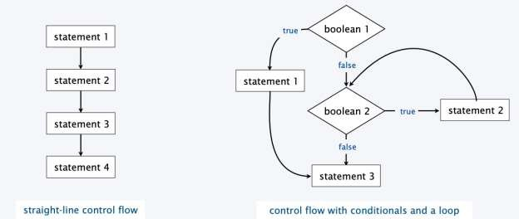
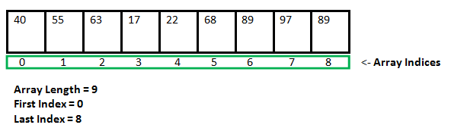
Overview
Conditionals
  The if & else statement
  Logical Operators
Loops
  The while statement
  The do while statement
  The for loop
How to use AI Tools Properly

Slide 3
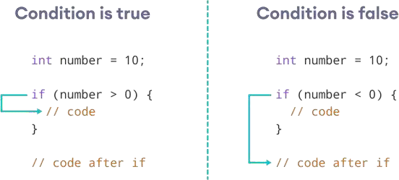
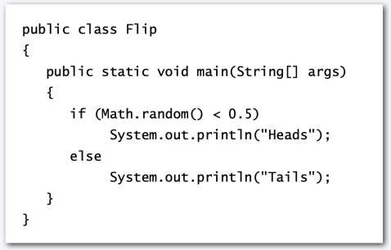
The if & else statement
Execute certain statements depending on the values of certain variables
Evaluate a boolean expression
If true, execute a statement, if false, do nothing
The else option: If false, execute a different statement

Slide 4
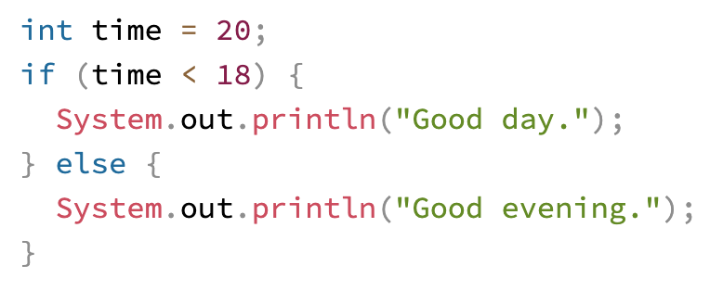
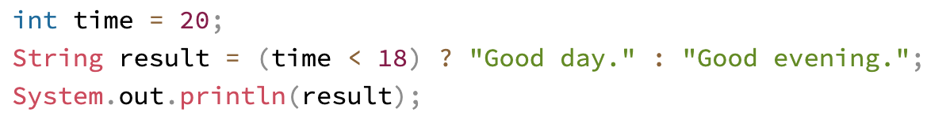
The if & else statement
Ternary Operator: A short version of if-else statement
variable = (condition) ? ExpressionTrue : ExpressionFalse;
Ref: https://www.w3schools.com/java/java_conditions_shorthand.asp

Slide 5
Logical Operators
AND (&&)
OR (||)
NOT (!)
If (a>b && b>c)
System.out.println(”a>c”)
If (a>c || b>c)
System.out.println(”One of a and b is larger than c”)
If (!(a>c))
System.out.println(”a<c”)
Ref: https://www.w3schools.com/java/java_conditions_shorthand.asp

Slide 6
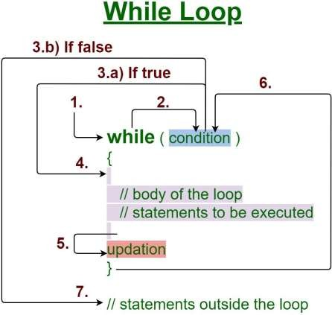
The while statement
Execute certain statements repeatedly until certain conditions are met
Evaluate a boolean expression
If true, execute a sequence of statements
Repeat
Cautions！
Add braces
Do not add the semicolon after the “while”

Slide 7
The while statement
Example: Build a countdown timer with while loop
int countdown = 5;
while (countdown > 0) {
System.out.println(countdown);
countdown--;
}
# Output: 5,4,3,2,1

Slide 8
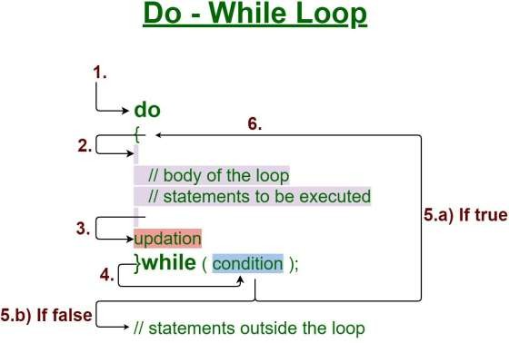
The do while statement
The do/while loop is a variant of the while loop
Execute the code block once before checking if the condition is true
Evaluate a boolean expression
If true, execute the code block again
Repeat

Slide 9
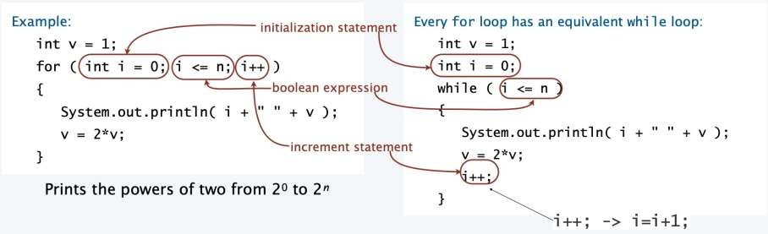
The for loop
An alternative repetition structure
Evaluate an initialization statement
Evaluate a boolean expression
If true, execute a sequence of statements, then execute an increment statement
Repeat

Slide 10
The for loop
Example1: Print numbers
for (int i = 0; i < 5; i++) {
System.out.println(i);
}
Example2: Print even numbers
for (int i = 0; i < 5; i=i+2) {
System.out.println(i);
}
Example2: Countdown
for (int i = 0; i < 5; i--) {
System.out.println(i);
}

Slide 11



How to use AI Tools Properly
As a beginner, do not completely rely on AI tools for your homework. Overusing AI tools introduce new traps in your study, such as
  Overestimating your progress: AI assistance can generate working code that surpasses your current understanding, you’re falling behind and don’t realize it.
  Trusting misleading advices: You trust a suggestion that seems right but actually takes you in the wrong direction.
  Getting distracted by suggestions: Every time you try to focus, an AI code-completion tool throws a suggestion at you, breaking your train of thought.

Slide 12
How to use AI Tools Properly
The goal is not to avoid AI entirely but to learn how to think effectively alongside it. Here are some suggestions for you during programming:
  Focus on Problem Solving, Not Just Output
    Struggling with code is part of learning.
    AI tools can generate code, but understanding the logic is essential for growth.
  Understand the Emotions of Learning
    Programming involves emotional highs and lows.
    Building confidence, resilience, and joy in coding is key to long-term success.
  Don’t Rush Towards ill-Conceived Code
    Fast coding often leads to more debugging.
    Plan your solution and data structures before writing any code.
Recommended Readings:
Learning to Think in an AI World: 5 Lessons for Novice Programmers | The JetBrains Academy Blog
Should You Use AI to Learn to Code? | The JetBrains Academy Blog

Slide 13
Q&A

